Slide 1

Streamlining Insurance Processes
Insurance Policy Automation Using Spring Boot

Slide 2


The Need for Insurance Automation
01
Enhanced Efficiency
Automating insurance processes significantly reduces manual tasks, allowing faster policy issuance and claims processing.
02
Improved Accuracy
Automation minimizes human errors, ensuring precise data handling and reliable outcomes in insurance operations.
03
Increased Customer Satisfaction
Streamlined processes and quicker service lead to improved customer experiences, fostering loyalty and retention.

Slide 3



Manual insurance systems are often inefficient and prone to errors.
These systems suffer from slow processing times, lack of transparency, and increased risk of mistakes, ultimately leading to customer dissatisfaction and higher operational costs.

Slide 4


Objectives of Insurance Automation
Key goals driving the automation of insurance processes include:
Enhance overall operational efficiency
Improve data accuracy and reliability
Ensure regulatory compliance at all levels
Enable scalable solutions for future growth

Slide 5
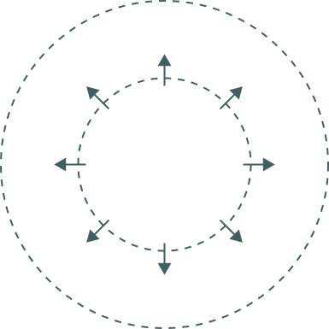
PRESENTATION LAYER
APPLICATION LAYER
The React front end handles user interactions and displays information dynamically.
Spring Boot processes data, handles requests, and enforces business logic.
DATABASE LAYER
INTEGRATION
MySQL stores all data securely, supporting efficient data retrieval and manipulation.
Components from all layers communicate seamlessly to deliver a cohesive user experience.

Slide 6
POLICY CREATION
CLAIM PROCESSING
Users submit policy applications through the web interface.
Claims are reviewed and assessed for validity and approval.
PAYMENT
REPORTING
Payments are processed securely based on claim approvals.
Detailed reports are generated for analysis and compliance tracking.

Slide 7
The ER diagram illustrates the relationships among various entities in the insurance automation system.
It details how policies, claims, and users interact, ensuring efficient data management and retrieval for seamless operations.

Slide 8
Backend Implementation Overview
01
Service Layer
The Service Layer handles business logic, ensuring that data processing is efficient and modular.
02
Data Access Layer
This layer interacts with the database, managing CRUD operations and abstracting data access for easier maintenance.
03
Controller Layer
The Controller Layer manages incoming requests, directing them to the appropriate service methods for processing.

Slide 9
Frontend Implementation Features
01
Dynamic UI Components
Our application utilizes dynamic UI components to enhance user engagement and provide a seamless experience.
02
API Integration
Efficient API integration allows for real-time data exchange between the frontend and backend systems, ensuring up-to-date information.
03
Form Validation
Robust form validation ensures accurate data entry, minimizing user errors and improving overall application reliability.

Slide 10
Testing & Deployment Overview
01
Postman Tests
Postman facilitates API testing, allowing for efficient validation of endpoints and responses during development.
02
Tomcat Server
Tomcat serves as the web server, enabling seamless deployment of the Spring Boot application for user access.
03
MySQL Database
MySQL ensures data persistence and integrity, supporting the application with a robust backend storage solution.

Slide 11
Key Benefits of Automation
01
Speed of Processing
Automation significantly reduces processing time, allowing for quicker policy issuance and claims approval.
02
Enhanced Security
Robust security measures protect sensitive data, ensuring customer information is safe from unauthorized access.
03
Increased Efficiency
Automation streamlines operations, minimizing human error and maximizing productivity across all business functions.

Slide 12
The future of insurance automation lies in AI, chatbots, and cloud deployment.
These innovations will enhance user experiences, streamline processes, and ensure scalable solutions for managing policies and claims effectively.

Slide 13


Thank You !

